Slide 1
MODELING AND ANALYSIS

Slide 2
Learning Objectives
Understand the basic concepts of Decision support system (DSS) modeling
Describe how DSS models interact with data and the user
Understand some different, well-known model classes
Understand how to structure decision making with a few alternatives

Slide 3
Learning Objectives
Describe how spreadsheets can be used for DSS modeling and solution
Describe how to structure a linear programming model
Explain the differences among algorithms, blind search, and heuristics

Slide 4
Learning Objectives
Explain the basic concepts of optimization, simulation, and heuristics, and when to use them
Explain what is meant by sensitivity analysis, what-if analysis, and goal seeking
Describe the key issues of model management

Slide 5
DSS Modeling
Current modeling issues
  Identification of the problem and environmental analysis
  Environmental scanning and analysis
  A process that involves conducting a search for and an analysis of information in external databases and flows of information

Slide 6
DSS Modeling
Current modeling issues
  Variable identification
  Forecasting
  Predicting the future
  Predictive analytics systems attempt to predict the most profitable customers, the worst customers, and focus on identifying products and services at appropriate prices to appeal to them
Notes:
Appeal جاذبية

Slide 7
DSS Modeling
Current modeling issues
  Multiple models: A DSS can include several models, each of which represents a different part of the decision-making problem
  Model categories
    Optimization of problems with few alternatives
    Optimization via algorithm
    Optimization via an analytic formula
    Simulation
    Predictive models
    Other models

Slide 8
DSS Modeling
Current modeling issues
  Model management
  Knowledge-based modeling
  Current trends
    Model libraries and solution technique libraries
    Development and use of Web tools

Slide 9
DSS Modeling
Current trends
  Multidimensional analysis (modeling)
  A modeling method that involves data analysis in several dimensions
  Influence diagram
  A diagram that shows the various types of variables in a problem (e.g., decision, independent, result) and how they are related to each other
Notes:
Influence diagram تأثير الرسم البياني

Slide 10
Mathematical Models

Slide 11
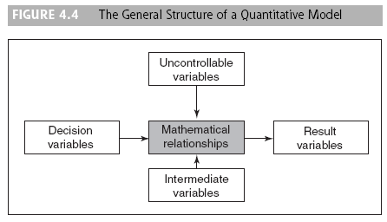
The Structure of Mathematical Models for Decision Support

Slide 12
The Structure of Mathematical Models for Decision Support
A variable that expresses the result of a decision (e.g., one concerning profit), usually one of the goals of a decision-making problem
A variable of a model that can be changed and manipulated by a decision maker. The decision variables correspond to the decisions to be made, such as quantity to produce and amounts of resources to allocate

Slide 13
The Structure of Mathematical Models for Decision Support
  Uncontrollable variable (parameter)
  A factor that affects the result of a decision but is not under the control of the decision maker. These variables can be internal (e.g., related to technology or to policies) or external (e.g., related to legal issues or to climate)
  Intermediate result variable
  A variable that contains the values of intermediate outcomes in mathematical models

Slide 14
Mathematical
Programming Optimization
Mathematical programming
A family of tools designed to help solve managerial problems in which the decision maker must allocate scarce resources among competing activities to optimize a measurable goal
Optimal solution
A best possible solution to a modeled problem
Notes:
scarce نادر
competing المتنافسة
optimize تحسين

Slide 15
Mathematical
Programming Optimization
Linear programming (LP)
A mathematical model for the optimal solution of resource allocation problems. All the relationships among the variables in this type of model are linear ( to be covered in detail the next lecture)

Slide 16
Multiple Goals, Sensitivity Analysis,
What-If Analysis, and Goal Seeking
Multiple goals
Refers to a decision situation in which alternatives are evaluated with several, sometimes conflicting, goals
Sensitivity analysis
A study of the effect of a change in one or more input variables on a proposed solution

Slide 17
Multiple Goals, Sensitivity Analysis,
What-If Analysis, and Goal Seeking
  Sensitivity analysis tests relationships such as:
    The impact of changes in external (uncontrollable) variables and parameters on the outcome variable(s)
    The impact of changes in decision variables on the outcome variable(s)
    The effect of uncertainty in estimating external variables
    The effects of different dependent interactions among variables
    The robustness of decisions under changing conditions

Slide 18
Multiple Goals, Sensitivity Analysis,
What-If Analysis, and Goal Seeking
  Sensitivity analyses are used for:
    Revising models to eliminate too-large sensitivities
    Adding details about sensitive variables or scenarios
    Obtaining better estimates of sensitive external variables
    Altering a real-world system to reduce actual sensitivities
    Accepting and using the sensitive (and hence vulnerable) real world, leading to the continuous and close monitoring of actual results
  The two types of sensitivity analyses are automatic and trial-and-error

Slide 19
Multiple Goals, Sensitivity Analysis,
What-If Analysis, and Goal Seeking
Automatic sensitivity analysis
  Automatic sensitivity analysis is performed in standard quantitative model implementations such as LP
Trial-and-error sensitivity analysis
  The impact of changes in any variable, or in several variables, can be determined through a simple trial-and-error approach

Slide 20
Multiple Goals, Sensitivity Analysis,
What-If Analysis, and Goal Seeking
What-If Analysis
  A process that involves asking a computer what the effect of changing some of the input data or parameters would be

Slide 21
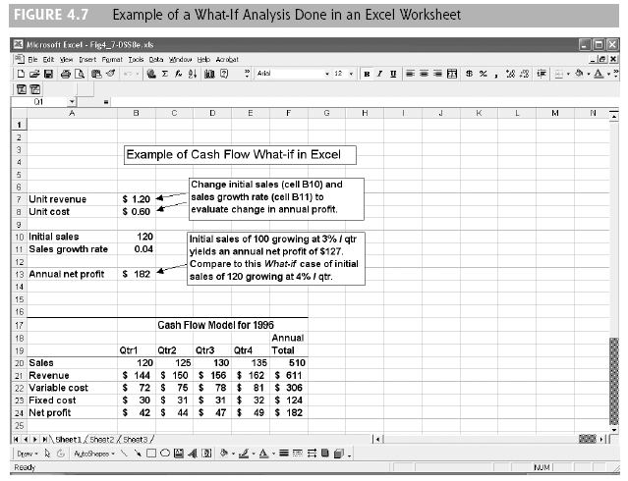
Multiple Goals, Sensitivity Analysis,
What-If Analysis, and Goal Seeking

Slide 22
Multiple Goals, Sensitivity Analysis,
What-If Analysis, and Goal Seeking
Goal seeking
Asking a computer what values certain variables must have in order to attain desired goals

Slide 23
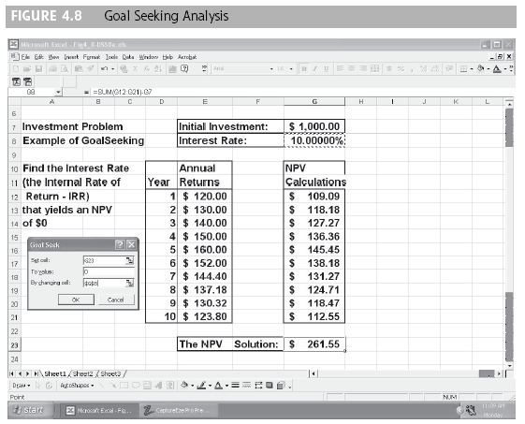
Multiple Goals, Sensitivity Analysis,
What-If Analysis, and Goal Seeking

Slide 24
Multiple Goals, Sensitivity Analysis,
What-If Analysis, and Goal Seeking
Computing a break-even point by using goal seeking
  Involves determining the value of the decision variables that generate zero profit

Slide 25
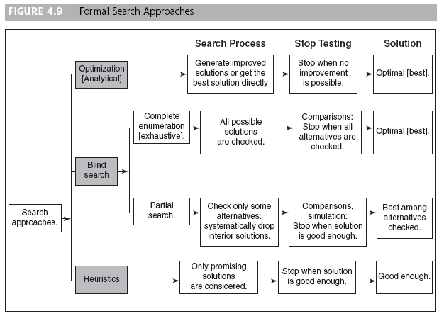
Problem-Solving Search Methods

Slide 26
Problem-Solving Search Methods
Analytical techniques use mathematical formulas to derive an optimal solution directly or to predict a certain result
An algorithm is a step-by-step search process for obtaining an optimal solution

Slide 27
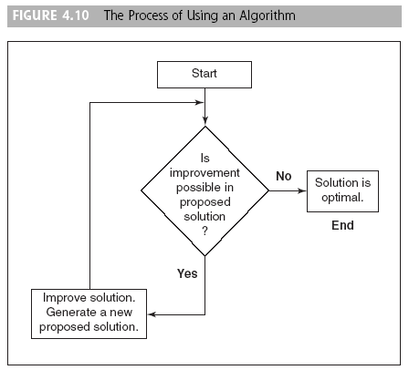
Problem-Solving Search Methods

Slide 28
Problem-Solving Search Methods
A goal is a description of a desired solution to a problem
The search steps are a set of possible steps leading from initial conditions to the goal
Problem solving is done by searching through the possible solutions

Slide 29
Problem-Solving Search Methods
Blind search techniques are arbitrary search approaches that are not guided
  In a complete enumeration all the alternatives are considered and therefore an optimal solution is discovered
  In an incomplete enumeration (partial search) continues until a good-enough solution is found (a form of suboptimization)

Slide 30
Problem-Solving Search Methods
Heuristic searching
  Heuristics
  Informal, judgmental knowledge of an application area that constitutes the rules of good judgment in the field. Heuristics also encompasses the knowledge of how to solve problems efficiently and effectively, how to plan steps in solving a complex problem, how to improve performance, and so forth
  Heuristic programming
  The use of heuristics in problem solving
Notes:
Heuristic searching البحث ارشادي

Slide 31
Simulation
Simulation : An imitation of reality
Major characteristics of simulation
  Simulation is a technique for conducting experiments
  Simulation is a descriptive rather than a normative method. there is no automatic search for an optimal solution.
  A simulation model describes or predicts the characteristics of a given system under different conditions.
  Simulation is normally used only when a problem is too complex to be treated using numerical optimization techniques

Slide 32
Advantages of simulation
  The theory is fairly straightforward.
  A great amount of time compression can be attained
  A manager can experiment with different alternatives
  The MSS builder must constantly interact with the manager
  The model is built from the manager’s perspective.
  The simulation model is built for one particular problem

Slide 33
Advantages of simulation
  Simulation can handle an extremely wide variety of problem types
  Simulation can include the real complexities of problems
  Simulation automatically produces many important performance measures
  Simulation can readily handle relatively unstructured problems
  There are easy-to-use simulation packages

Slide 34
Disadvantages of simulation
  An optimal solution cannot be guaranteed
  Simulation model construction can be a slow and costly process
  Solutions and inferences from a simulation study are usually not transferable to other problems
  Simulation is sometimes so easy to explain to managers that analytic methods are often overlooked
  Simulation software sometimes requires special skills because of the complexity of the formal solution method.

Slide 35
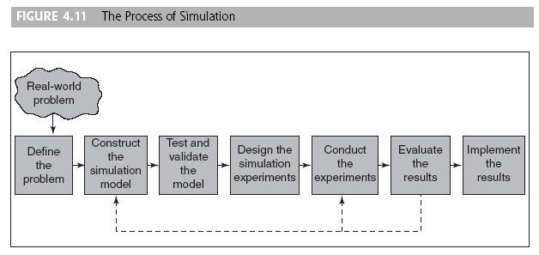
The Methodology of Simulation

Slide 36
The Methodology of Simulation
Simulation involves setting up a model of a real system and conducting repetitive experiments on it. The methodology consists of the following steps:
1. Define the problem. We examine and classify the real-world problem – we specify why a simulation approach is appropriate. .
2. Construct the simulation model. This step involves determination of the variables and their relationships, as well as data gathering.
3. Test and validate the model. The simulation model must represent the system being studied.

Slide 37
The Methodology of Simulation
4.Design the simulation experiments. When the model has been proven valid, an experiment is designed – how long to run the simulation (accuracy and cost?).
5. Conduct the experiments: involves issues ranging from random-number generation to result presentation.
6. Evaluate the results. The results must be interpreted – sensitivity analysis.
7. Implement the results. The chances of success are better because the manager is usually more involved with the simulation process then other models.

Slide 38
Simulation Types
Probabilistic Simulation. The independent variables are probabilistic:
  Discrete distributions – a situation with a limited number of events (variables) that can take on only a finite number of values.
  Continuous distributions – unlimited number of possible events that follow density functions, such as the normal distribution.
Time-Dependent Simulation – is important to know the precise time of arrival.
Time-Independent Simulation - is not important to know exactly when the event occurred.
Object-oriented Simulation. SIMPROCESS: object-oriented process modeling tool that lets the user create a simulation model by using screen-based objects. UML could be used in practice for modeling complex, real-time systems.
Visual Simulation. The graphical display of computerized results, which may include animation, is one of the most successful developments in computer-human interaction and problem solving.

Slide 39
Visual Interactive Simulation
Conventional simulation inadequacies
  Simulation reports statistical results at the end of a set of experiments
  Decision makers are not an integral part of simulation development and experimentation
  Decision makers’ experience and judgment cannot be used directly
  Confidence gap occurs if the simulation results do not match the intuition or judgment of the decision maker

Slide 40
Visual Interactive Simulation
Visual interactive simulation or visual interactive modeling (VIM)
A simulation approach used in the decision-making process that shows graphical animation in which systems and processes are presented dynamically to the decision maker. It enables visualization of the results of different potential actions

Slide 41
Visual Interactive Simulation
Visual Interactive models and DSS
  Waiting-line management (queuing) is a good example of VIM
  The VIM approach can also be used in conjunction with artificial intelligence
  General-purpose commercial dynamic VIS software is readily available

